Slide 1
SDN-BASED MALICIOUS NETWORK TRAFFIC DEFENSE SOLUTION
Team: 15
ClassID:14,18,19, 36

Slide 2
PROJECT MOTIVATION
SDN Advantages : Centralized, Flexible, Programmable, Scalibility
Security: Cyber Attack -> Network Mapping
Monitoring real-time statisitcal flow chart
2. Fake Listening host with almost no cost
3. Block, Redirect flow to fake listening host

Slide 3
DDOS
Type: HTTP, TCP sync, UDP, ICMP packets
Multi-Attackers
block web services with large amount requests
Hard to detect in very beginning

Slide 4
ENVIRONMENT
Network Devices: Mininet in VM - topology
Controller: Floodlight - global view
Network Monitor: sFlow - collect statistics
Protocol: OpenFlow1.3
REST API

Slide 5




TOPOLOGY
bait Server
Malicious Hosts
Server

Slide 6

TOPOLOGY
Floodlight Controller
Malicious Hosts
Server

Slide 7

TOPOLOGY
REST API
Floodlight Controller
Malicious Hosts
Server

Slide 8
REST API APPLICATION
Over Http request (GET/POST)
Recommended way to implement first floodlight app
But…
Limit and version dependent

Slide 9
FLOODLIGHT MODULE
Current floodlight modules do not meet our needs
Create our own modules
Monitor ICMP Echo Request
Monitor TCP or UDP Request
Monitor HTTP GET of POST Request
How to develop a flood module
Inherit from IOFMessageListener, IFloodlightModule
Implement Resource class to provides data to applications
Implement Routable class to provides REST API
Define Serializer class to generate Json

Slide 10
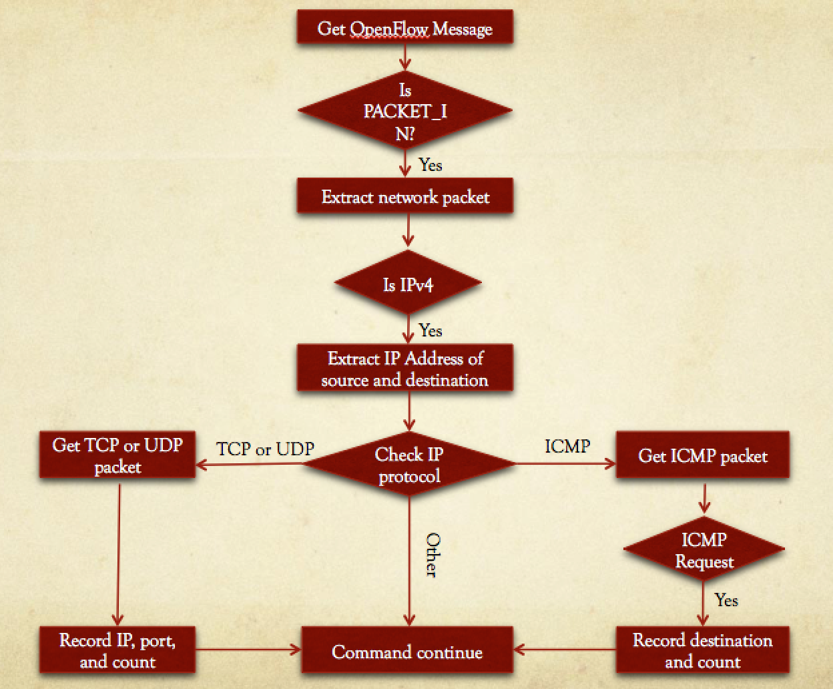
HeaderExtract
A floodlight module
Developed by ourselves
Monitor ICMP
Monitor TCP or UDP Request

Slide 11
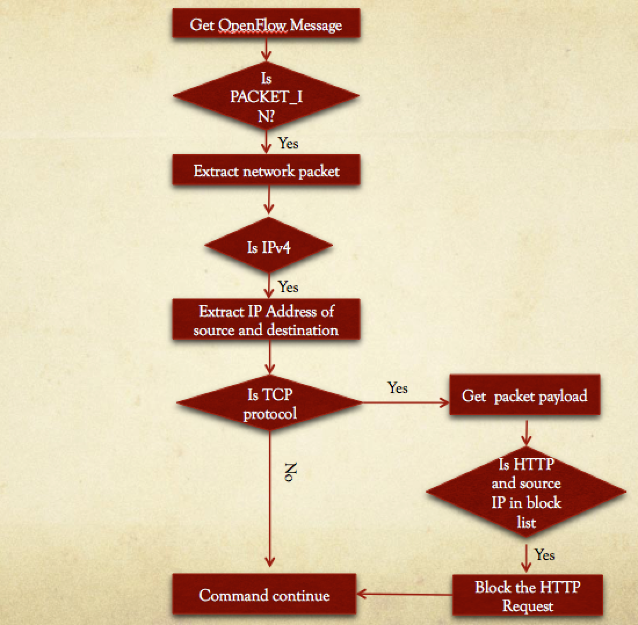
HTTPFilter
A floodlight module
Developed by ourselves
Monitor HTTP Request
Drop specific IP HTTP Request

Slide 12
MININET
Realistic Virtual Network on VM, cloud, anywhere
Deploy Networks a click with Scripting Language
Ideal experiment environment with OpenFlow and Software-Defined Networking

Slide 13
PROJECT GOAL
Develope an REST API application with Floodlight Controller
Methodology:
Monitoring the flow with src-dst pairs
DDos detected, send flow rule on sentinel switch Redirect malicious traffic to fake hosts

Slide 14

SCENARIO
Floodlight Controller
icmp ddos
sentinel switch
tcp ddos
sentinel switch

Slide 15
FLOW TABLE IN SENTINEL SWITCH
ipv4_src | ipv4_dst | ip_proto=0x06 (TCP) | ip_proto=0x11(UDP) | icmpv4_type=8(ICMP) | tcp_dst=80(http)
10.0.0.1 | 10.0.0.8 |  |  | 51
10.0.0.2 | 10.0.0.8 |  |  |  | 349
10.0.0.3 | 10.0.0.5
10.0.0.1 | 10.0.0.5

Slide 16
PSEUDO CODE
if ip_src && ip_dst not in hash_table: hash_table[ip_dst][ip_src-ip_dst]->counter =0 ddos_table[ip_dst]++ hash_table[ip_dst][ip_src-ip_dst]++ for ddos_count in ddos_table: if ddos_threshold > threshold: switches = get_route_switch(ip_src, ip_dst) apply_redirect(switch, ip_src) for switch in switches apply_block(switch, ip_src) for switch in switches
match field can be TCP/UDP/ICMP/TCP_port

Slide 17

SCENARIO
Floodlight Controller
Forward Flow Rule!
tcp ddos
DDos Detect!

Slide 18

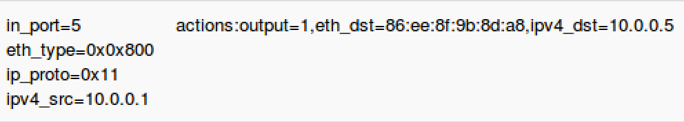
SCENARIO
Floodlight Controller
Redirect
tcp ddos
DDos Detect!

Slide 19
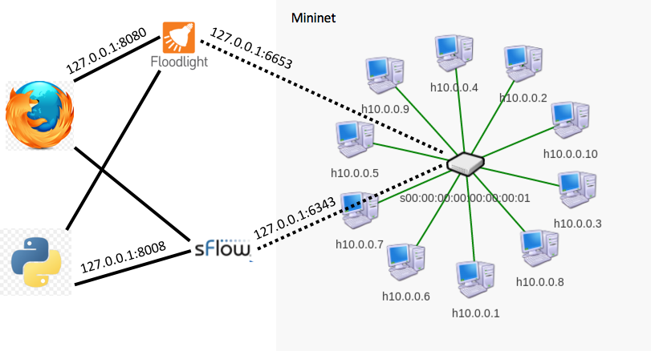
TOPOLOGY

Slide 20
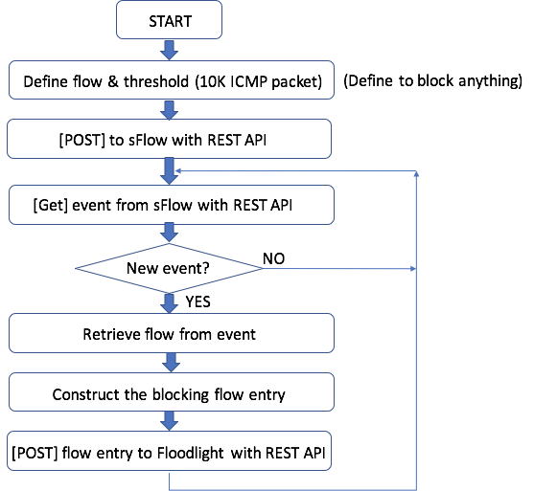
Flow Chart

Slide 21
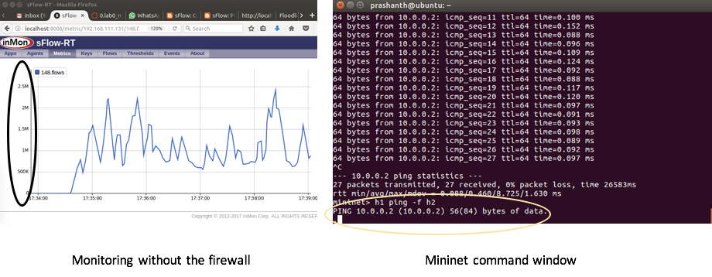

Slide 22
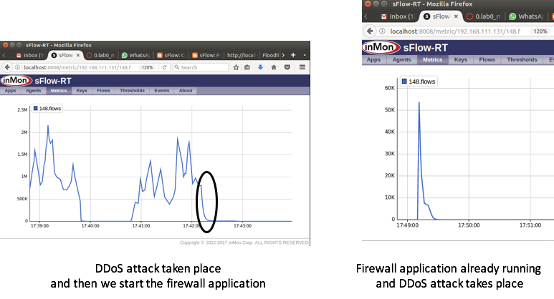

Slide 23
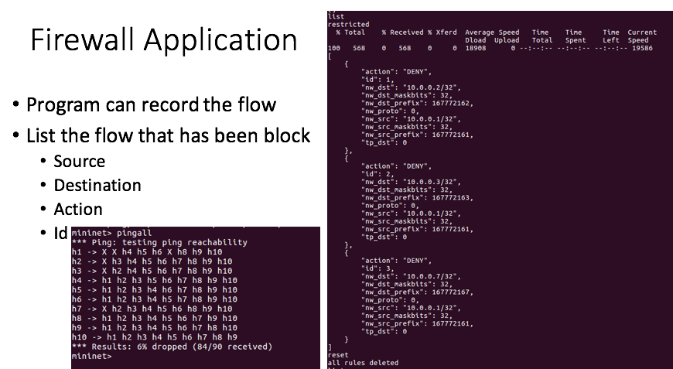

Slide 24
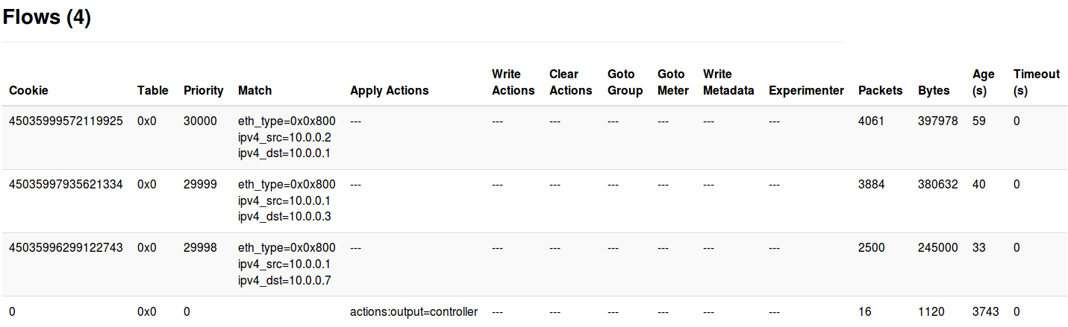

Slide 25
CONCLUSION
Floodlight modules provide REST API to develop application but limited
You can contribute your module to Floodlight!

Slide 26
DEMO

